Slide 1

Chapter 34
Community of Practice in Uralic Studies (COPIUS), www.copius.eu
Introduction to Mari
Jeremy Bradley, jeremy.moss.bradley@univie.ac.at
Last updated 13 May 2022

Slide 2
The European Commission's support for the production of this publication does not constitute an endorsement of the contents, which reflect the views only of the authors, and the Commission cannot be held responsible for any use which may be made of the information contained therein.

Slide 3
Grammar

Slide 4
1. The clitic -ат linking clauses
Паша гыч толамат, чыла ыштем. | As soon as I get back from work, I’ll do it all.
Йыван пашаш лектын каят, ватыжат погынаш тӱҥалеш. | As soon as Yyvan leaves for work, his wife starts getting ready too.
Аня Светалан книгам пуышат, шке сомылжо дене умбаке куржо. | Anya gave Sveta the book and ran off to take care of her own tasks.
Ключников серыш лектат, саламлалташ тӱнал’е. | Klyuchnikov stepped onto the shore and started greeting people.
Изам армий гыч толят, университетыш тунемаш пурыш. | As soon as my brother returned from the army, he entered university.
Окна гычын модшо йоча-влакым онченамат, мыят уремыш модаш лектым. | When I saw the children playing through the window, I went outside to play too.
Вася философий нерген книгам лудынат, мален колтен. | Vasya read a book about philosophy and fell asleep.
Шольым школым пытарен ылят, армийыш нальыч. | My brother had just finished school and was drafted to the army.
Валя пеш ноен улмашат, пашажым пытарыде коден. | Valya was very tired, so her work was left undone.
-меке:
-ат, …:

Slide 5
1. The clitic -ат linking clauses
Паша гыч толамат, чыла ыштем. | As soon as I get back from work, I’ll do it all.
Йыван пашаш лектын каят, ватыжат погынаш тӱҥалеш. | As soon as Yyvan leaves for work, his wife starts getting ready too.
Аня Светалан книгам пуышат, шке сомылжо дене умбаке куржо. | Anya gave Sveta the book and ran off to take care of her own tasks.
Ключников серыш лектат, саламлалташ тӱнал’е. | Klyuchnikov stepped onto the shore and started greeting people.
Изам армий гыч толят, университетыш тунемаш пурыш. | As soon as my brother returned from the army, he entered university.
Окна гычын модшо йоча-влакым онченамат, мыят уремыш модаш лектым. | When I saw the children playing through the window, I went outside to play too.
Вася философий нерген книгам лудынат, мален колтен. | Vasya read a book about philosophy and fell asleep.
Шольым школым пытарен ылят, армийыш нальыч. | My brother had just finished school and was drafted to the army.
Валя пеш ноен улмашат, пашажым пытарыде коден. | Valya was very tired, so her work was left undone.
-меке:
-ат, …:

Slide 6
2. Verbal derivation
‘to perform an action involving N’
Translative verbs
Factitive verbs
Frequentative verbs
Reflexive verbs
Causative verbs
Momentary verbs

Slide 7
2. Verbal derivation
a) ‘to perform an action involving N’
a1) -л^{II}
там | taste | тамлаш (‑ем) | to taste
ак | price; value | аклаш (‑ем) | to assess, to grade
сӱрет | picture | сӱретлаш (‑ем) | to draw, to paint
салам | greeting | саламлаш (‑ем) | to greet; to congratulate
ямде | ready | ямдылаш (‑ем) | to prepare
(Russian)
организовать | to organize | организоватлаш (‑ем)
транскрибировать | to transcribe

Slide 8
2. Verbal derivation
a) ‘to perform an action involving N’
a1) -л^{II}
там | taste | тамлаш (‑ем) | to taste
ак | price; value | аклаш (‑ем) | to assess, to grade
сӱрет | picture | сӱретлаш (‑ем) | to draw, to paint
салам | greeting | саламлаш (‑ем) | to greet; to congratulate
ямде | ready | ямдылаш (‑ем) | to prepare
(Russian)
организовать | to organize | организоватлаш (‑ем)
транскрибировать | to transcribe | транскрибироватлаш (‑ем)

Slide 9
2. Verbal derivation
b) Translative verbs
b1) -аҥ^{I}
кӱ | stone | кӱаҥаш (‑ам) | to turn to stone
лопка | wide | лопкаҥаш (‑ам) | to become wider
вий | force, power, strength | вияҥаш (‑ам) | to become stronger
окса | money | оксаҥаш (‑ам) | to become rich, to earn money
шешке | daughter-in-law | шешкаҥаш (‑ем)

Slide 10
2. Verbal derivation
b) Translative verbs
b1) -аҥ^{I}
кӱ | stone | кӱаҥаш (‑ам) | to turn to stone
лопка | wide | лопкаҥаш (‑ам) | to become wider
вий | force, power, strength | вияҥаш (‑ам) | to become stronger
окса | money | оксаҥаш (‑ам) | to become rich, to earn money
шешке | daughter-in-law | шешкаҥаш (‑ем) | to get a daughter-in-law

Slide 11
2. Verbal derivation
b) Translative verbs
b2) -лан^{II}
чер | illness | черланаш (‑ем) | to fall ill
вер | place | верланаш (‑ем) | to be situated/placed
чаҥга | stingy | чаҥгаланаш (‑ем) | to be/become stingy
мут | word | мутланаш (‑ем) | to talk, to discuss
койыш | nature, appearance | койышланаш (‑ем)

Slide 12
2. Verbal derivation
b) Translative verbs
b2) -лан^{II}
чер | illness | черланаш (‑ем) | to fall ill
вер | place | верланаш (‑ем) | to be situated/placed
чаҥга | stingy | чаҥгаланаш (‑ем) | to be/become stingy
мут | word | мутланаш (‑ем) | to talk, to discuss
койыш | nature, appearance | койышланаш (‑ем) | to pose, to flaunt

Slide 13
2. Verbal derivation
b) Translative verbs
b3) -ем^{I}
ошо | white | ошемаш (‑ам) | to become white
неле | heavy | нелемаш (‑ам) | to grow heavy
сай | good | саемаш (‑ам) | to get better
у | new | уэмаш (‑ам) | to be renewed
изи | small, little | иземаш (‑ам)

Slide 14
2. Verbal derivation
b) Translative verbs
b3) -ем^{I}
ошо | white | ошемаш (‑ам) | to become white
неле | heavy | нелемаш (‑ам) | to grow heavy
сай | good | саемаш (‑ам) | to get better
у | new | уэмаш (‑ам) | to be renewed
изи | small, little | иземаш (‑ам) | to shrink (intr.)

Slide 15
2. Verbal derivation
b) Translative verbs
b4) -ешт^{I}
кас | evening | касешташ (‑ам) | to become evening
шулдо | cheap | шулдешташ (‑ам) | to become cheap(er)
мотор | beautiful | моторешташ (‑ам)

Slide 16
2. Verbal derivation
b) Translative verbs
b4) -ешт^{I}
кас | evening | касешташ (‑ам) | to become evening
шулдо | cheap | шулдешташ (‑ам) | to become cheap(er)
мотор | beautiful | моторешташ (‑ам) | to grow in beauty

Slide 17
2. Verbal derivation
b) Translative verbs
b5) -г^{II}
лавыра | dirt | лавыргаш (‑ем) | to become dirty
ӱмыл | shade; shadow | ӱмылгаш (‑ем) | to grow dark
сусыр | wound | сусыргаш (‑ем)

Slide 18
2. Verbal derivation
b) Translative verbs
b5) -г^{II}
лавыра | dirt | лавыргаш (‑ем) | to become dirty
ӱмыл | shade; shadow | ӱмылгаш (‑ем) | to grow dark
сусыр | wound | сусыргаш (‑ем) | to be wounded

Slide 19
2. Verbal derivation
c) Factitive verbs
c1) -д^{II} ~ -т^{II}
лӱм | name | лӱмдаш (‑ем) | to name
кыл | connection | кылдаш (‑ем) | to connect
ӱмыл | shade | ӱмылташ (‑ем) | to shade
кадыр | crooked | кадырташ (‑ем)

Slide 20
2. Verbal derivation
c) Factitive verbs
c1) -д^{II} ~ -т^{II}
лӱм | name | лӱмдаш (‑ем) | to name
кыл | connection | кылдаш (‑ем) | to connect
ӱмыл | shade | ӱмылташ (‑ем) | to shade
кадыр | crooked | кадырташ (‑ем) | to bend, to curve

Slide 21
2. Verbal derivation
d) Frequentative verbs
d1) -л^{I}
ышташ (‑ем) | to do | ыштылаш (‑ам) | to do
лӱмдаш (‑ем) | to name | лӱмдылаш (‑ам) | to call names
чоҥешташ (‑ем) | to fly | чоҥештылаш (‑ам) | to fly
шындаш (‑ем) | to put, to place | шындылаш (‑ам)

Slide 22
2. Verbal derivation
d) Frequentative verbs
d1) -л^{I}
ышташ (‑ем) | to do | ыштылаш (‑ам) | to do
лӱмдаш (‑ем) | to name | лӱмдылаш (‑ам) | to call names
чоҥешташ (‑ем) | to fly | чоҥештылаш (‑ам) | to fly
шындаш (‑ем) | to put, to place | шындылаш (‑ам) | to set, to arrange

Slide 23
2. Verbal derivation
d) Frequentative verbs
d2) -ед^{II}
кошташ (‑ам) | to go | коштедаш (‑ем) | to stroll, to wander
лияш (‑ям) | to be, to happen | лиедаш (‑ем) | to be, to happen
ужалаш (‑ем) | to sell | ужаледаш (‑ем) | to sell
пуаш (‑эм) | to give | пуэдаш (‑ем)

Slide 24
2. Verbal derivation
d) Frequentative verbs
d2) -ед^{II}
кошташ (‑ам) | to go | коштедаш (‑ем) | to stroll, to wander
лияш (‑ям) | to be, to happen | лиедаш (‑ем) | to be, to happen
ужалаш (‑ем) | to sell | ужаледаш (‑ем) | to sell
пуаш (‑эм) | to give | пуэдаш (‑ем) | to distribute

Slide 25
2. Verbal derivation
d) Frequentative verbs
d3) -кал^{II}
каласаш (‑ем) | to say, to speak | каласкалаш (‑ем) | to talk, to tell
висаш (‑ем) | to measure | вискалаш (‑ем) | to measure
соваш (‑ем) | to clap, to applaud | совкалаш (‑ем)

Slide 26
2. Verbal derivation
d) Frequentative verbs
d3) -кал^{II}
каласаш (‑ем) | to say, to speak | каласкалаш (‑ем) | to talk, to tell
висаш (‑ем) | to measure | вискалаш (‑ем) | to measure
соваш (‑ем) | to clap, to applaud | совкалаш (‑ем) | to clap, to applaud

Slide 27
2. Verbal derivation
d) Frequentative verbs
d4) -(е)шт^{I}
шелаш (‑ам) | to break, to chop | шелышташ (‑ам) | to cleave, to chop
колаш (‑ам) | to hear | колышташ (‑ам) | to listen
лӱҥгаш (‑ем) | to rock, to shake | лӱҥгешташ (‑ам) | to stagger, to reel
шуаш (‑ам) | to sharpen, to whittle | шуэшташ (‑ам)

Slide 28
2. Verbal derivation
d) Frequentative verbs
d4) -(е)шт^{I}
шелаш (‑ам) | to break, to chop | шелышташ (‑ам) | to cleave, to chop
колаш (‑ам) | to hear | колышташ (‑ам) | to listen
лӱҥгаш (‑ем) | to rock, to shake | лӱҥгешташ (‑ам) | to stagger, to reel
шуаш (‑ам) | to sharpen, to whittle | шуэшташ (‑ам) | to sharpen, to whittle

Slide 29
2. Verbal derivation
e) Reflexive verbs
e1) -(а)лт^{I}
кылдаш (‑ем) | to connect | кылдалташ (‑ам) | to be connected
возаш (‑ем) | to write | возалташ (‑ам) | to be written
почаш (‑ам) | to open (tr.) | почылташ (‑ам) | to be opened, to open (intr.)
мушкаш (‑ам) | to wash | мушкылташ (‑ам)

Slide 30
2. Verbal derivation
e) Reflexive verbs
e1) -(а)лт^{I}
кылдаш (‑ем) | to connect | кылдалташ (‑ам) | to be connected
возаш (‑ем) | to write | возалташ (‑ам) | to be written
почаш (‑ам) | to open (tr.) | почылташ (‑ам) | to be opened, to open (intr.)
мушкаш (‑ам) | to wash | мушкылташ (‑ам) | to wash oneself

Slide 31
2. Verbal derivation
f) Causative verbs
f1) -кт^{II}
ыраш (‑ем) | to become warm | ырыкташ (‑ем) | to warm up
ончаш (‑ем) | to look | ончыкташ (‑ем) | to show
шонаш (‑ем) | to think | шоныкташ (‑ем)

Slide 32
2. Verbal derivation
f) Causative verbs
f1) -кт^{II}
ыраш (‑ем) | to become warm | ырыкташ (‑ем) | to warm up
ончаш (‑ем) | to look | ончыкташ (‑ем) | to show
шонаш (‑ем) | to think | шоныкташ (‑ем) | to make (someone) think

Slide 33
2. Verbal derivation
f) Causative verbs
f2) -д^{II} ~ -т^{II}
шолаш (‑ам) | to boil (intr.) | шолташ (‑ем) | to boil (tran.)
пураш (‑ем) | to enter | пурташ (‑ем) | to bring in, to lead into
лопкаҥаш (‑ам) | to become wider | лопкаҥдаш (‑ем) | to widen, to make wider
вияҥаш (‑ам) | to become stronger | вияҥдаш (‑ем) | to make stronger
нелемаш (‑ам) | to grow heavy | нелемдаш (‑ем) | to make heavier
саемаш (‑ам) | to get better | саемдаш (‑ем)

Slide 34
2. Verbal derivation
f) Causative verbs
f2) -д^{II} ~ -т^{II}
шолаш (‑ам) | to boil (intr.) | шолташ (‑ем) | to boil (tran.)
пураш (‑ем) | to enter | пурташ (‑ем) | to bring in, to lead into
лопкаҥаш (‑ам) | to become wider | лопкаҥдаш (‑ем) | to widen, to make wider
вияҥаш (‑ам) | to become stronger | вияҥдаш (‑ем) | to make stronger
нелемаш (‑ам) | to grow heavy | нелемдаш (‑ем) | to make heavier
саемаш (‑ам) | to get better | саемдаш (‑ем) | to make better, to improve

Slide 35
2. Verbal derivation
f) Causative verbs
f3) -дар^{II} ~ -тар^{II}
йомаш (‑ам) | to become lost | йомдараш (‑ем) | to lose
чапланаш (‑ем) | to enjoy fame | чапландараш (‑ем) | to glorify
куанаш (‑ем) | to be happy | куандараш (‑ем) | to make happy
шижаш (‑ам) | to feel, to sense | шижтараш (‑ем) | to notify, to inform
умылаш (‑ем) | to understand | умылтараш (‑ем)

Slide 36
2. Verbal derivation
f) Causative verbs
f3) -дар^{II} ~ -тар^{II}
йомаш (‑ам) | to become lost | йомдараш (‑ем) | to lose
чапланаш (‑ем) | to enjoy fame | чапландараш (‑ем) | to glorify
куанаш (‑ем) | to be happy | куандараш (‑ем) | to make happy
шижаш (‑ам) | to feel, to sense | шижтараш (‑ем) | to notify, to inform
умылаш (‑ем) | to understand | умылтараш (‑ем) | to explain

Slide 37
2. Verbal derivation
g) Momentary verbs
g1) -алт^{II}
канаш (‑ем) | to rest | каналташ (‑ем) | to rest, to relax
шонаш (‑ем) | to think | шоналташ (‑ем) | to think, to consider
вучаш (‑ем) | to wait | вучалташ (‑ем)

Slide 38
2. Verbal derivation
g) Momentary verbs
g1) -алт^{II}
канаш (‑ем) | to rest | каналташ (‑ем) | to rest, to relax
шонаш (‑ем) | to think | шоналташ (‑ем) | to think, to consider
вучаш (‑ем) | to wait | вучалташ (‑ем) | to wait (a little)

Slide 39
2. Verbal derivation
g) Momentary verbs
g2) -ал^{I}
мураш (‑ем) | to sing | муралаш (‑ам) | to sing (a bit)
шогаш (‑ем) | to stand | шогалаш (‑ам) | to stand up
ончаш (‑ем) | to look, to see | ончалаш (‑ам)

Slide 40
2. Verbal derivation
g) Momentary verbs
g2) -ал^{I}
мураш (‑ем) | to sing | муралаш (‑ам) | to sing (a bit)
шогаш (‑ем) | to stand | шогалаш (‑ам) | to stand up
ончаш (‑ем) | to look, to see | ончалаш (‑ам) | to look

Slide 41
Words and word usage

Slide 42
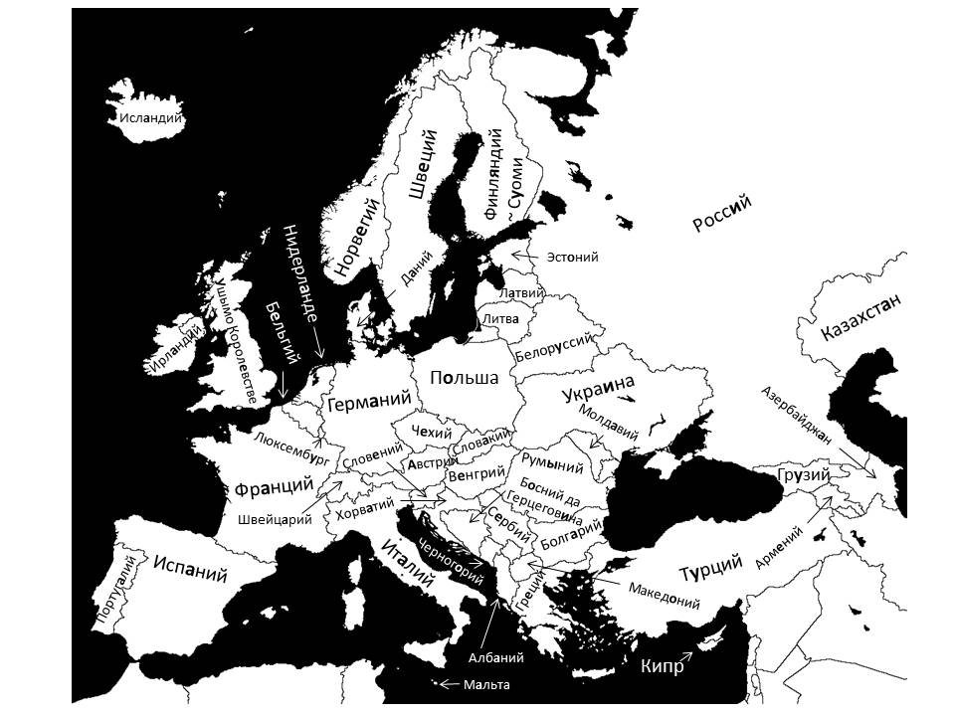
1. Суоми ‘Finland’ and other European countries
Польша
‘Poland’
>
Польшышто
‘in Poland’

Slide 43
2. я ‘or’
Вуйшовычым я кидыштым нунылан рӱзат. | They wave at them with their scarfs or hands.
Я толат, я от тол. | Either you come or you don’t.
Радиом таче шуко вере колыштыт: я мӧҥгыштӧ, я пашаште, я корнышто, я стадионышто. | People listen to the radio in many places today: at home, at work, on the road, in a stadium.

Slide 44
3. кӧ … кӧ ‘some … others’
Кӧ келша, кӧ ваштареш. | Some are for, others are against.
Кӧ классик сынаным, кӧ куштылго манмым, ал’е поп-музыкым, йӧрата, а кӧм калык сем кумылаҥда. | Some love classical (music), some like what you could call light (music), or pop music, and others find pleasure in folk melodies.

Slide 45
4. вере
вес вере | in another place, somewhere else, elsewhere
тӱрлӧ вере | in different places
чыла вере | everywhere, anywhere
шагал вере | in few places
шуко вере | in many places
южо вере | in some places
ик вере | in one place
кок вере | in two places
кум вере | in three places

Slide 46
🌲
5. Directional constructions
🐿️
Verbal pairing | Literal translation | Factual translation
ийын лекташ (‑ам) | to swimming leave | to swim out
ийын пураш (‑ем) | to swimming enter | to swim in
чоҥештен лекташ (‑ам) | to flying leave | to fly out
чоҥештен пураш (‑ем) | to flying enter | to fly in
шӱдырен лукташ (‑ам) | to dragging remove | to drag out
шӱдырен пурташ (‑ем) | to dragging bring in | to drag in
поктен лукташ (‑ам) | to driving remove | to drive out
поктен пурташ (‑ем) | to driving bring in | to drive in

Slide 47
5. Directional constructions
Directionality | Intransitive | Transitive
in, into | пураш (‑ем) | пурташ (‑ем)
away | каяш (‑ем) | наҥгаяш (‑ем)
out | лекташ (‑ам) | лукташ (‑ам)
down, downwards | волаш (‑ем) | волташ (‑ем)
up | кӱзаш (‑ем) | кӱзыкташ (‑ем)
across, over | вончаш (‑ем) | -
apart | ойырлаш (‑ем) | ойыраш (‑ем)
past, by | эрташ (‑ем) | -
(coming) | толаш (‑ам) | кондаш (‑ем)
up to | мияш (‑ем) | намияш (‑ем)
through (perforating) | шӱташ (‑ем) | шӱтлаш (‑ем)

Slide 48
5. Directional constructions
???
Verbal pairing | Literal translation | Factual translation
толын шуаш (‑ам) | to coming arrive | to arrive
лектын каяш (‑ем) | to leaving go | to go out, to go away
миен толаш (‑ам) | to going come | to visit, to drop in, to drop by
миен пураш (‑ем) | to coming enter | to visit
толын пураш (‑ем) | to coming enter | to come in
пурен лекташ (‑ам) | to entering leave | to drop in, to visit
Кечываллан толын шуат мо? | Will you make it here by noon?
Аня ала-молан сырен: чеверласыде лектын кайыш. | Anya got angry for some reason; she left without saying good-bye.
Теҥгече Ивановмыт деке унала миен толынна. | We visited the Ivanovs yesterday.
Пӧртышкӧ толын пурышна гына – уремыште йӱр тӱҥал’е. | We had just entered the house; outside, it began to rain.

Slide 49
6. Auxiliary constructions
a) шогалташ (‑ем) ‘to place, to stand’
b) пышташ (‑ем) ‘to put, to place, to lay’
d) шындаш (‑ем) ‘to put, to place, to set’
Ивановым адак школ директорын кабинетышкыже пуртен шогалтеныт. | Ivanov was sent to the principal’s office again.
Ушем вуйлатышылан Петровым сайлен шогалтеныт. | Petrov was elected director of the society.
Ончал, могай полатым чоҥен шогалтеныт! | Look what a mansion they’ve built!
Чыла документым ик папкыш поген пыште. | Put all the documents into one folder.
Сравочым кушко шылтен пыштенат? Мылам каяш кӱлеш. | Where did you hide the key? I need to leave.
Тудо марий йылмым келгын тунемаш шонен пыштен. | (S)he decided to study Mari properly.
Таче школышто маленам: мыйым тушакын йоҥылыш петырен шынденыт. | I slept at school tonight; I got locked in by mistake.
Рвезе-влак 8-ше мартлан чапле пӧлекым ямдылен шынденыт. | The boys made a very nice present for the 8th of March.
Эчан Эвикам икымше ончалтыш гыч йӧратен шынден. | Echan fell in love with Evika on first sight.

Slide 50
6. Auxiliary constructions
c) опташ (‑ем) ‘to put, to place, to lay (several items)’
Тынар кочкышым молан ыштен оптенат? Кастене шагал кочман. | Why did you make so much food? In the evening, you should only eat a little.
Ивановым бандит-влак кырен оптеныт – ынде эмлымверыште кия. | The bandits beat up Ivanov; now he’s lying in the hospital.
Кудывечышкына йоча-влаклан модаш ошмам конден оптеныт. | They brought sand into our yard for the children to play in.

Slide 51
Text

Slide 52
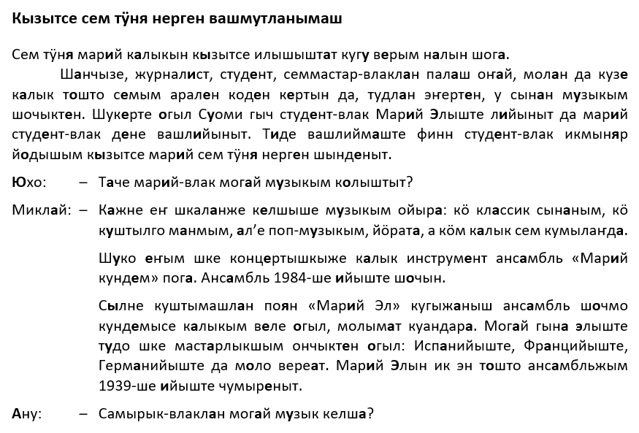
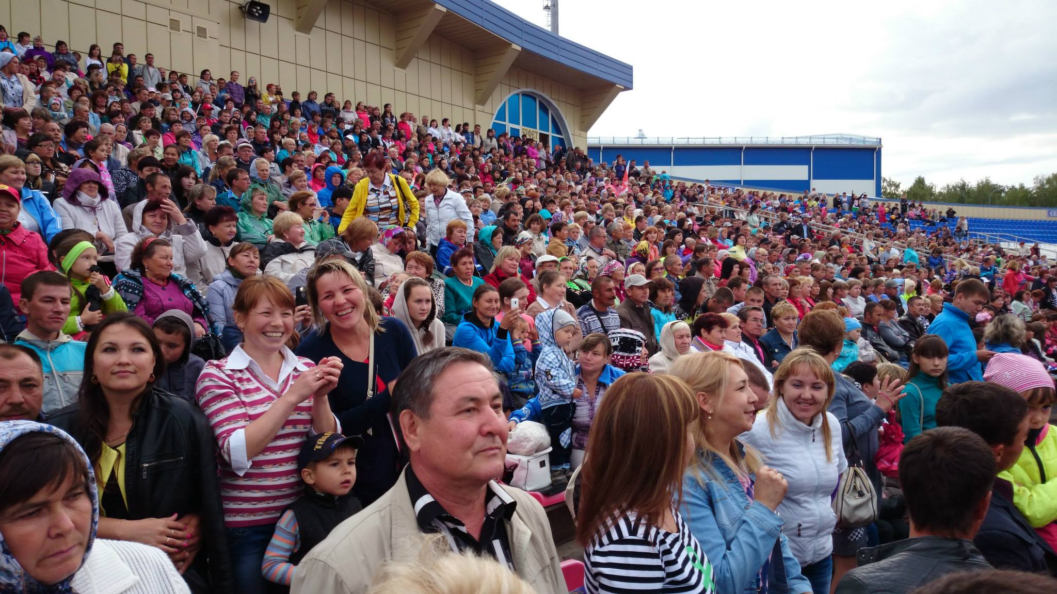

Slide 53
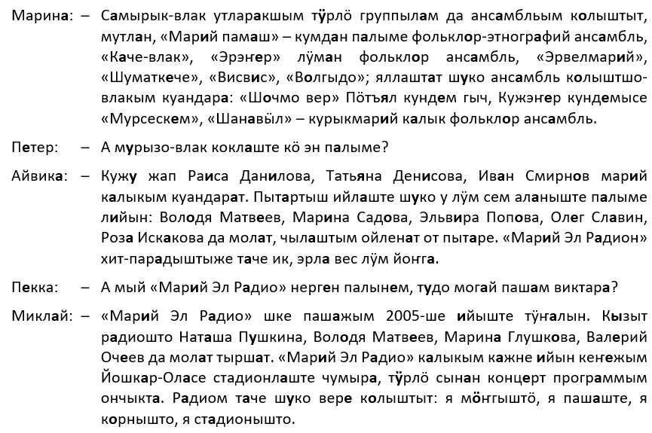

Slide 54
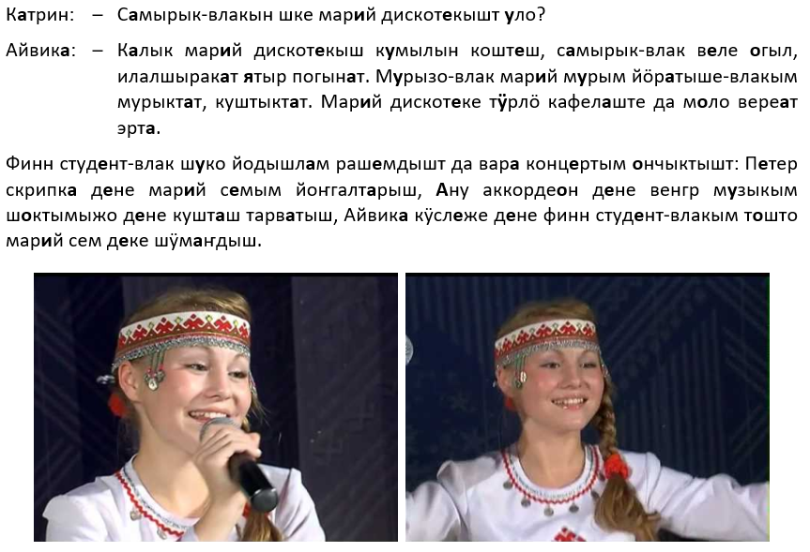

Slide 55
Exercises

Slide 56
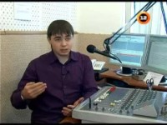
15.
www.youtube.com/watch?v=6dJsRL_N9FM

Slide 57
