Slide 1

Chapter 05
Community of Practice in Uralic Studies (COPIUS), www.copius.eu
Introduction to Mari
Jeremy Bradley, jeremy.moss.bradley@univie.ac.at
Last updated 18 January 2024

Slide 2
The European Commission's support for the production of this publication does not constitute an endorsement of the contents, which reflect the views only of the authors, and the Commission cannot be held responsible for any use which may be made of the information contained therein.

Slide 3
Review

Slide 4
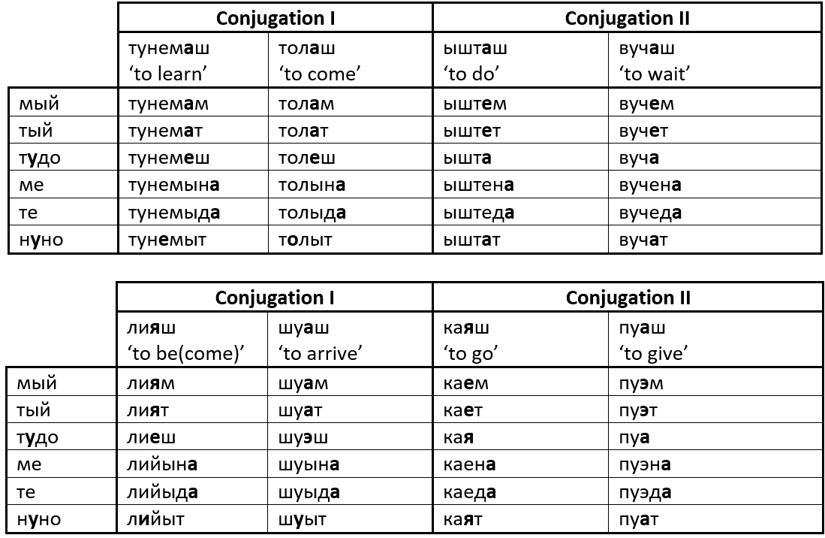
1. Conjugation: present tense

Slide 5
1. Conjugation: present tense

Slide 6
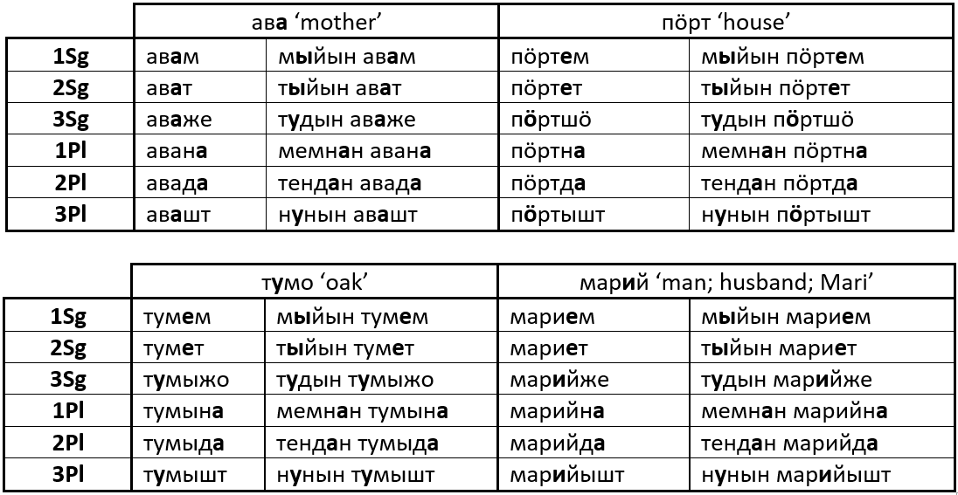
2. Possessive suffixes

Slide 7
2. Possessive suffixes

Slide 8
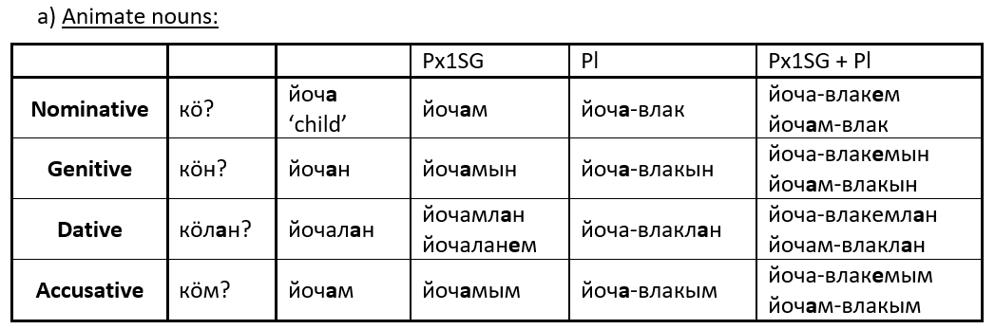
3. Case suffixes, plural

Slide 9
3. Case suffixes, plural

Slide 10
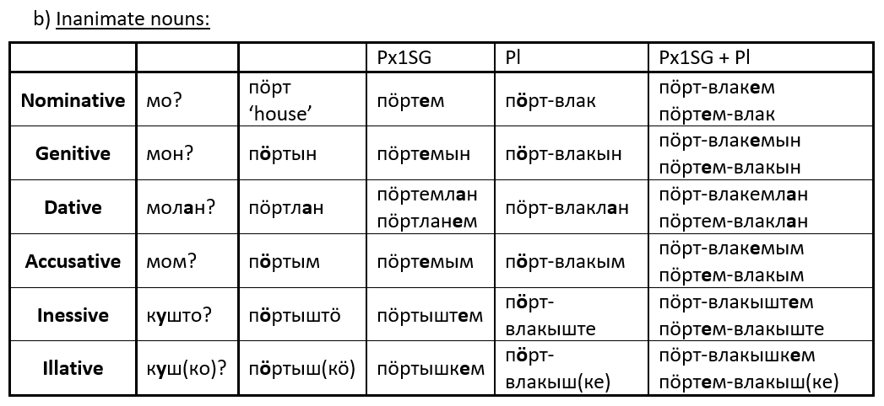
3. Case suffixes, plural

Slide 11
3. Case suffixes, plural

Slide 12
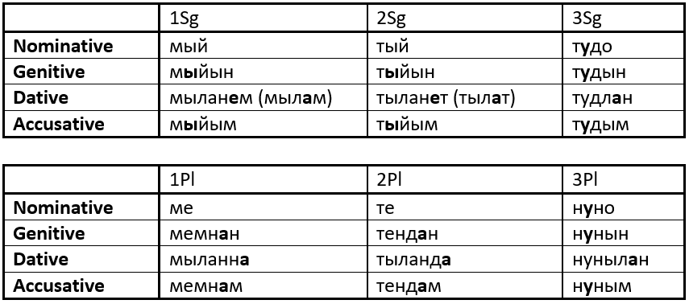
4. Personal pronouns

Slide 13
4. Personal pronouns

Slide 14
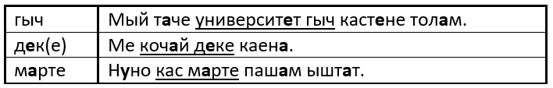
5. Postpositions

